Slide 1

AIR QUALITY MONITORING SYSTEM
2021
Presented by : 19WH1A0227 – BH. SAI SRUTHI – III EEE
19WH1A0229 – P.SNEHA - III EEE
19WH1A0240 –K.GAYATHRI- III EEE
19WH1A0243 –CH.LIKHITHA- III EEE

Slide 2
Problem statement : Deteriorating air quality
2021
How healthy is the air we breathe ?...

Slide 3
What is air quality index ?
AQI is an overall scheme that transforms individual air pollutant (e.g. SO₂, CO, PM₁₀) levels into a single number, which is a simple and lucid description of air quality for the citizens.
AQI relates to health impacts and citizens can avoid the unnecessary exposure to air pollutants;
AQI indicates compliance with National Air Quality Standards;
AQI prompts local authorities to take quick actions to improve air quality;
AQI encourages citizens to participate in air quality management.
[AQI]

Slide 4
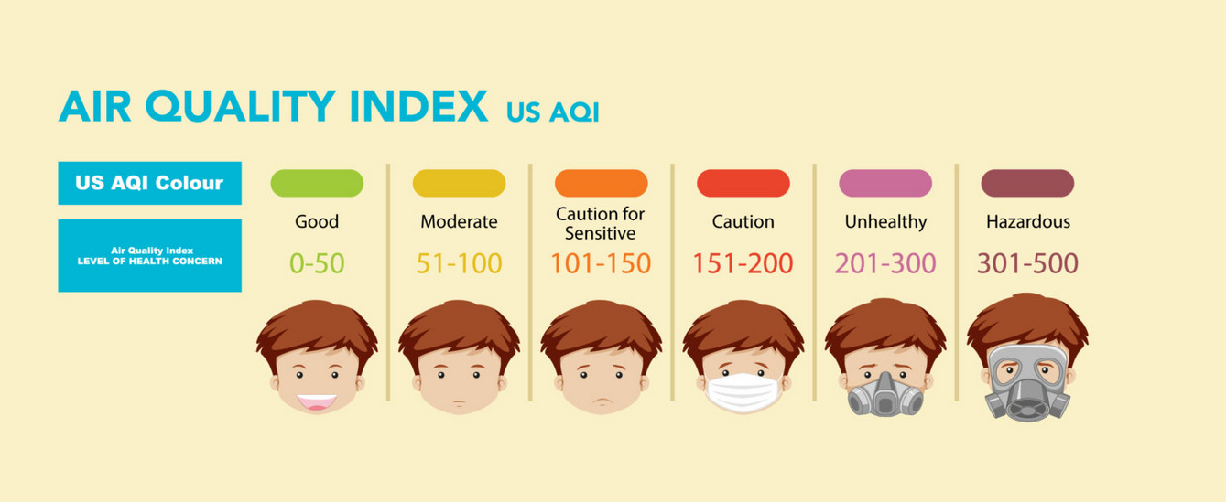
AQI CATEGORIES AND RANGES
2021

Slide 5
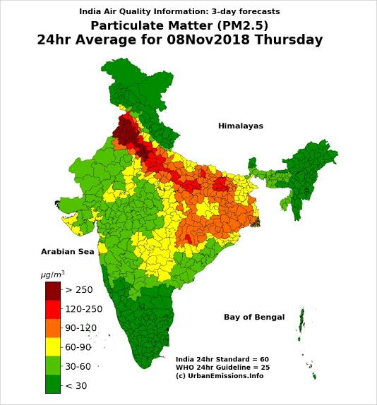
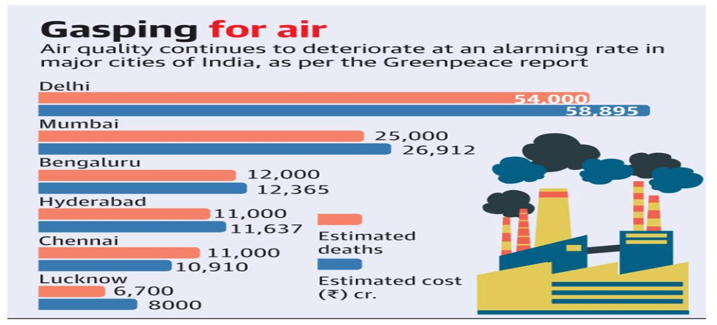
AIR QUALITY IN INDIA
20XX

Slide 6
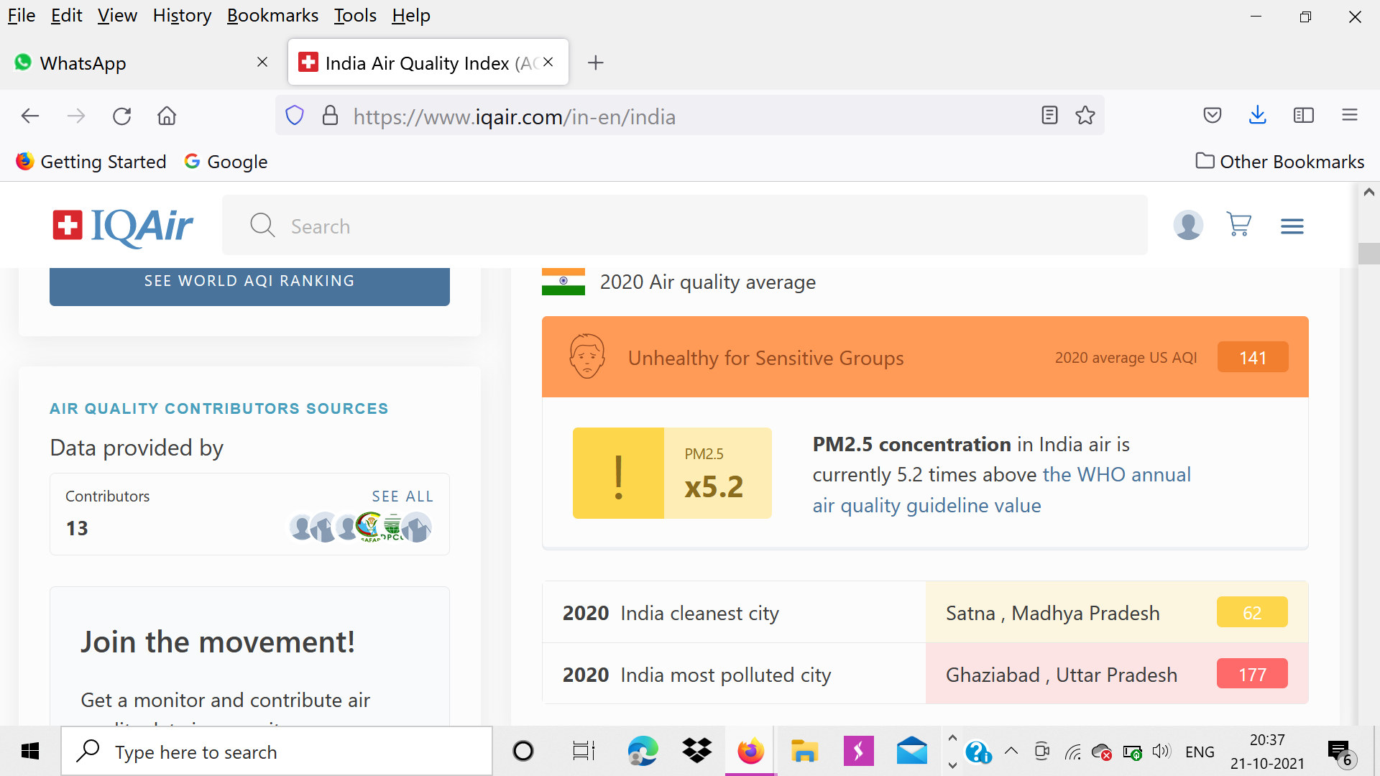
Current situation of India !!!
2021
As part of a worldwide survey, it was discovered that 21 out of the 30 most polluted cities were in India .
This pushed India's ranking as a country to 5th place.

Slide 7
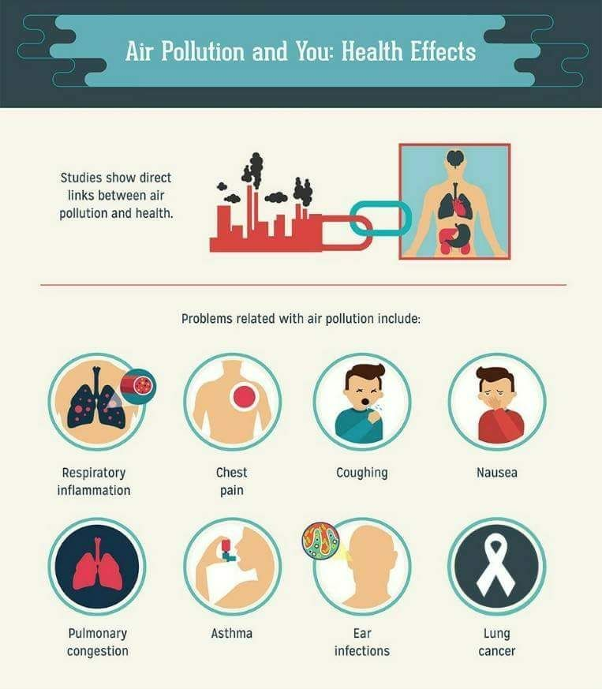

Slide 8
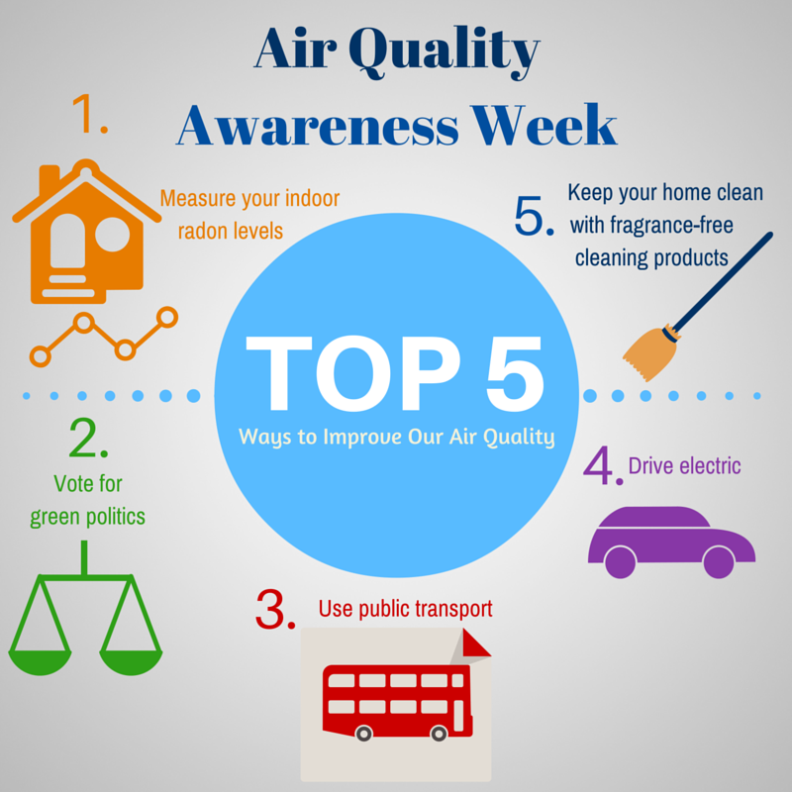
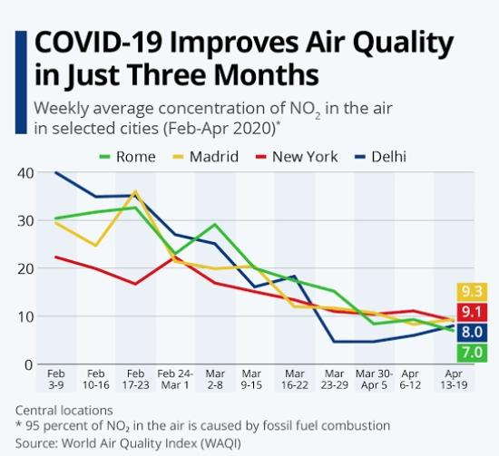
2021

Slide 9
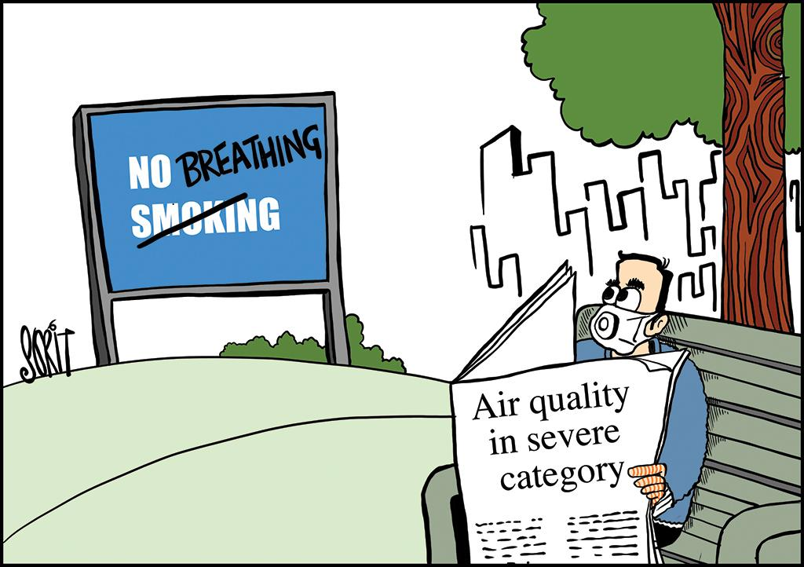
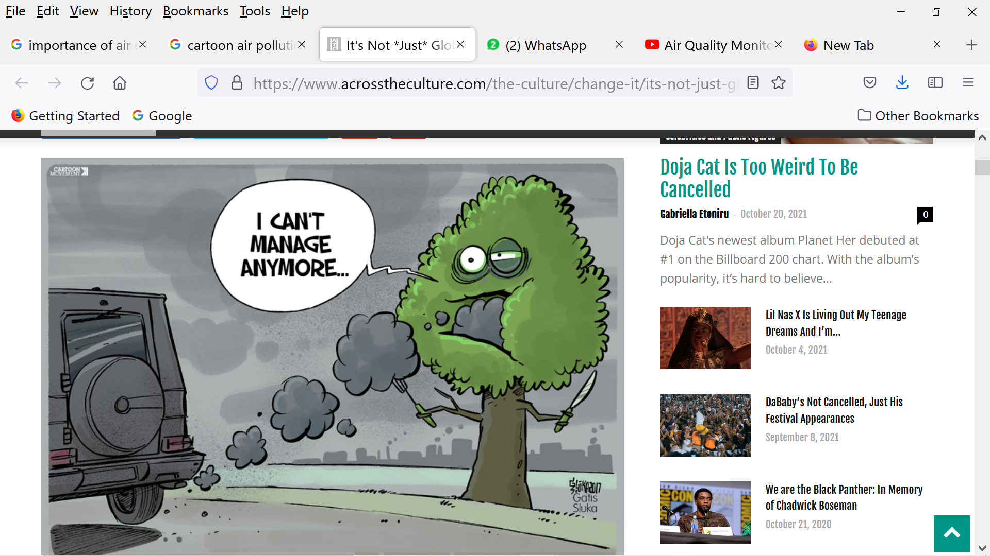
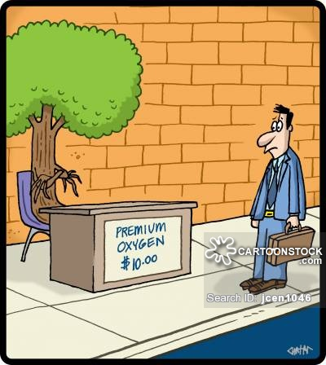
Stop this before it’s too late !
20XX

Slide 10
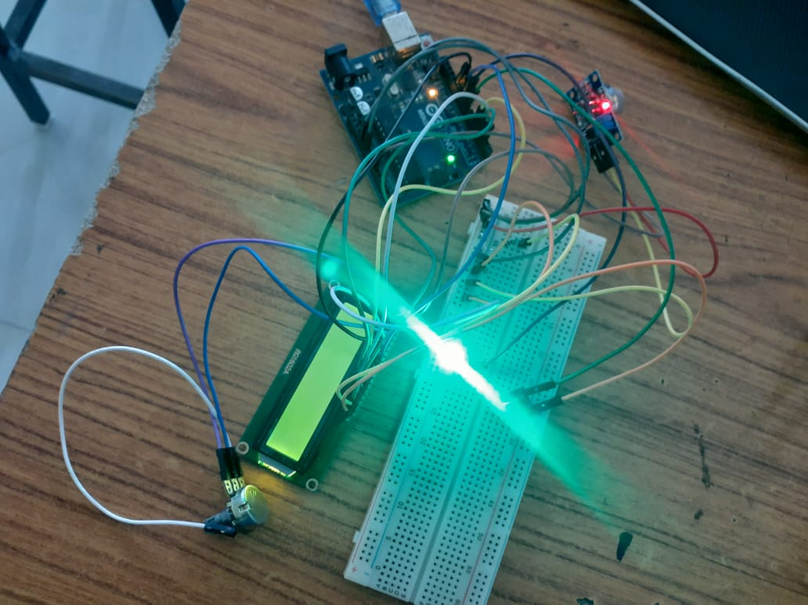
Our idea – Air quality monitoring and alert system
2021
Components
Arduino
Lcd display
Gas sensor (MQ135)
Potentiometer
Led
Buzzer
Jumper Cables
Breadboard
Resistor
Basic prototype

Slide 11






Approach
2021
Collecting information
Analyzing
Providing output
Gathers information through sensors
Compare the received data with given constraints
Displaying result accordingly
Data storage
Graph display
Conclusion
Maintaining the AQI values in terminal
Displaying the data pictorially for easy understanding
Concluding the air quality

Slide 12
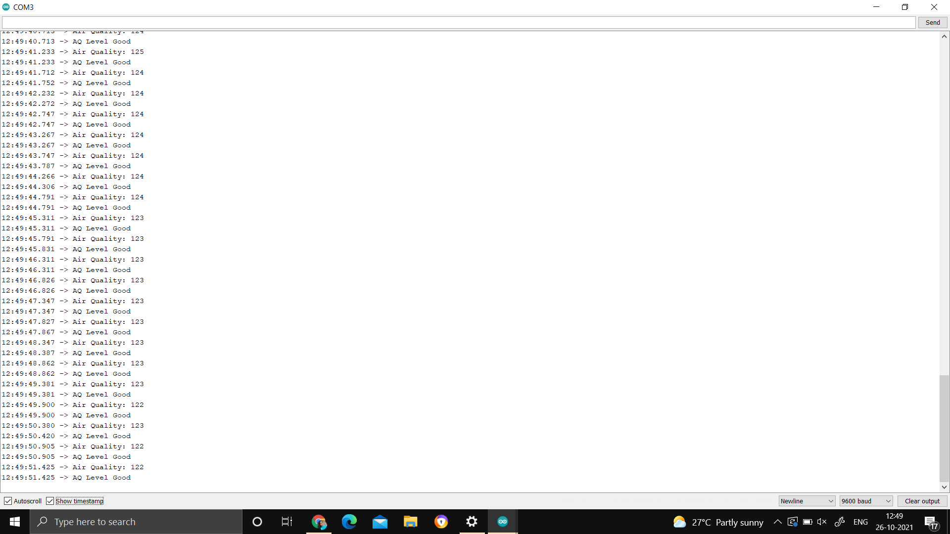
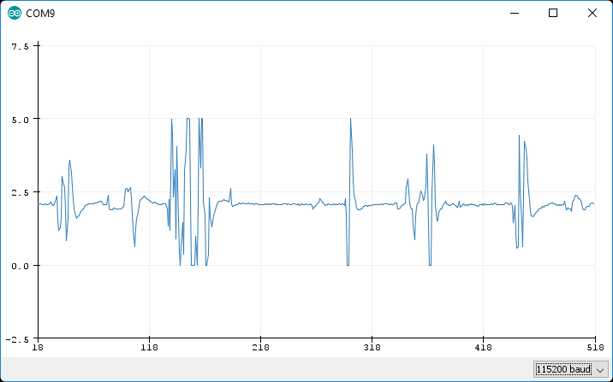
Plotted graph using serial plotter
2021
Values recorded from terminal
12

Slide 13
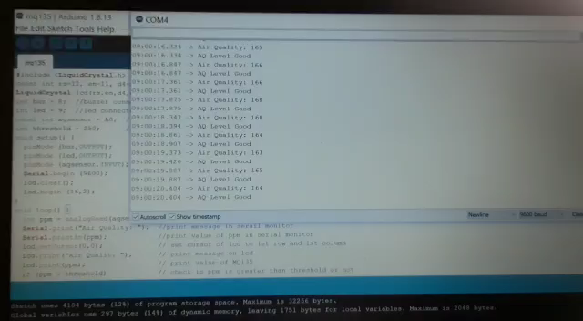
Our results for indoor environment

Slide 14
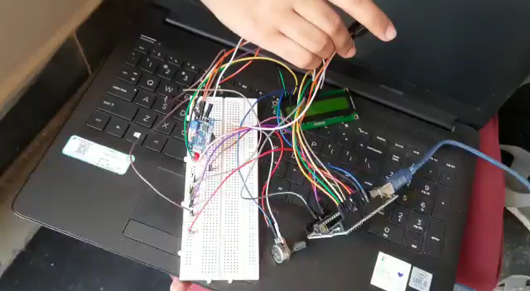
Our results for outdoor environment
2021

Slide 15
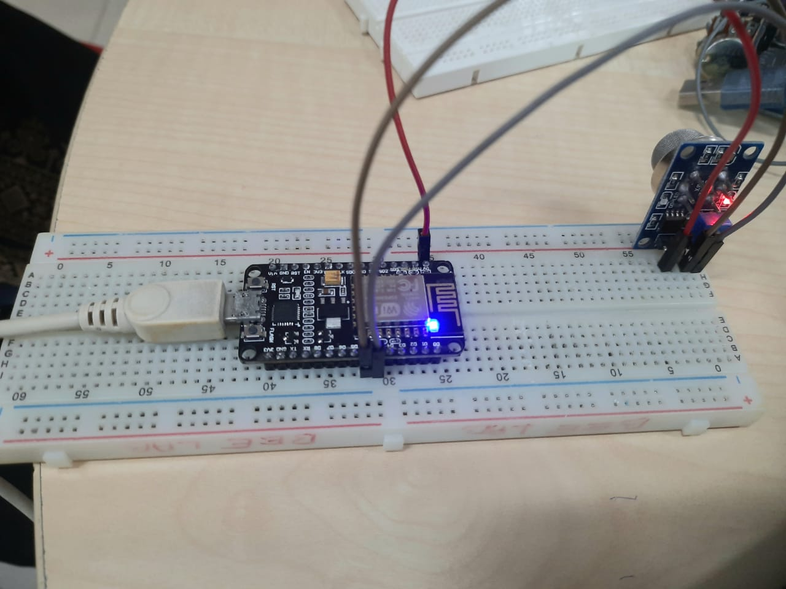
Connecting with Thing speak(IOT)
2021
Components
Node mcu
(ESP 8266)
MQ 135
Idea
Using thing speak to store the values in cloud
Providing values and graphs in thing speak channel

Slide 16
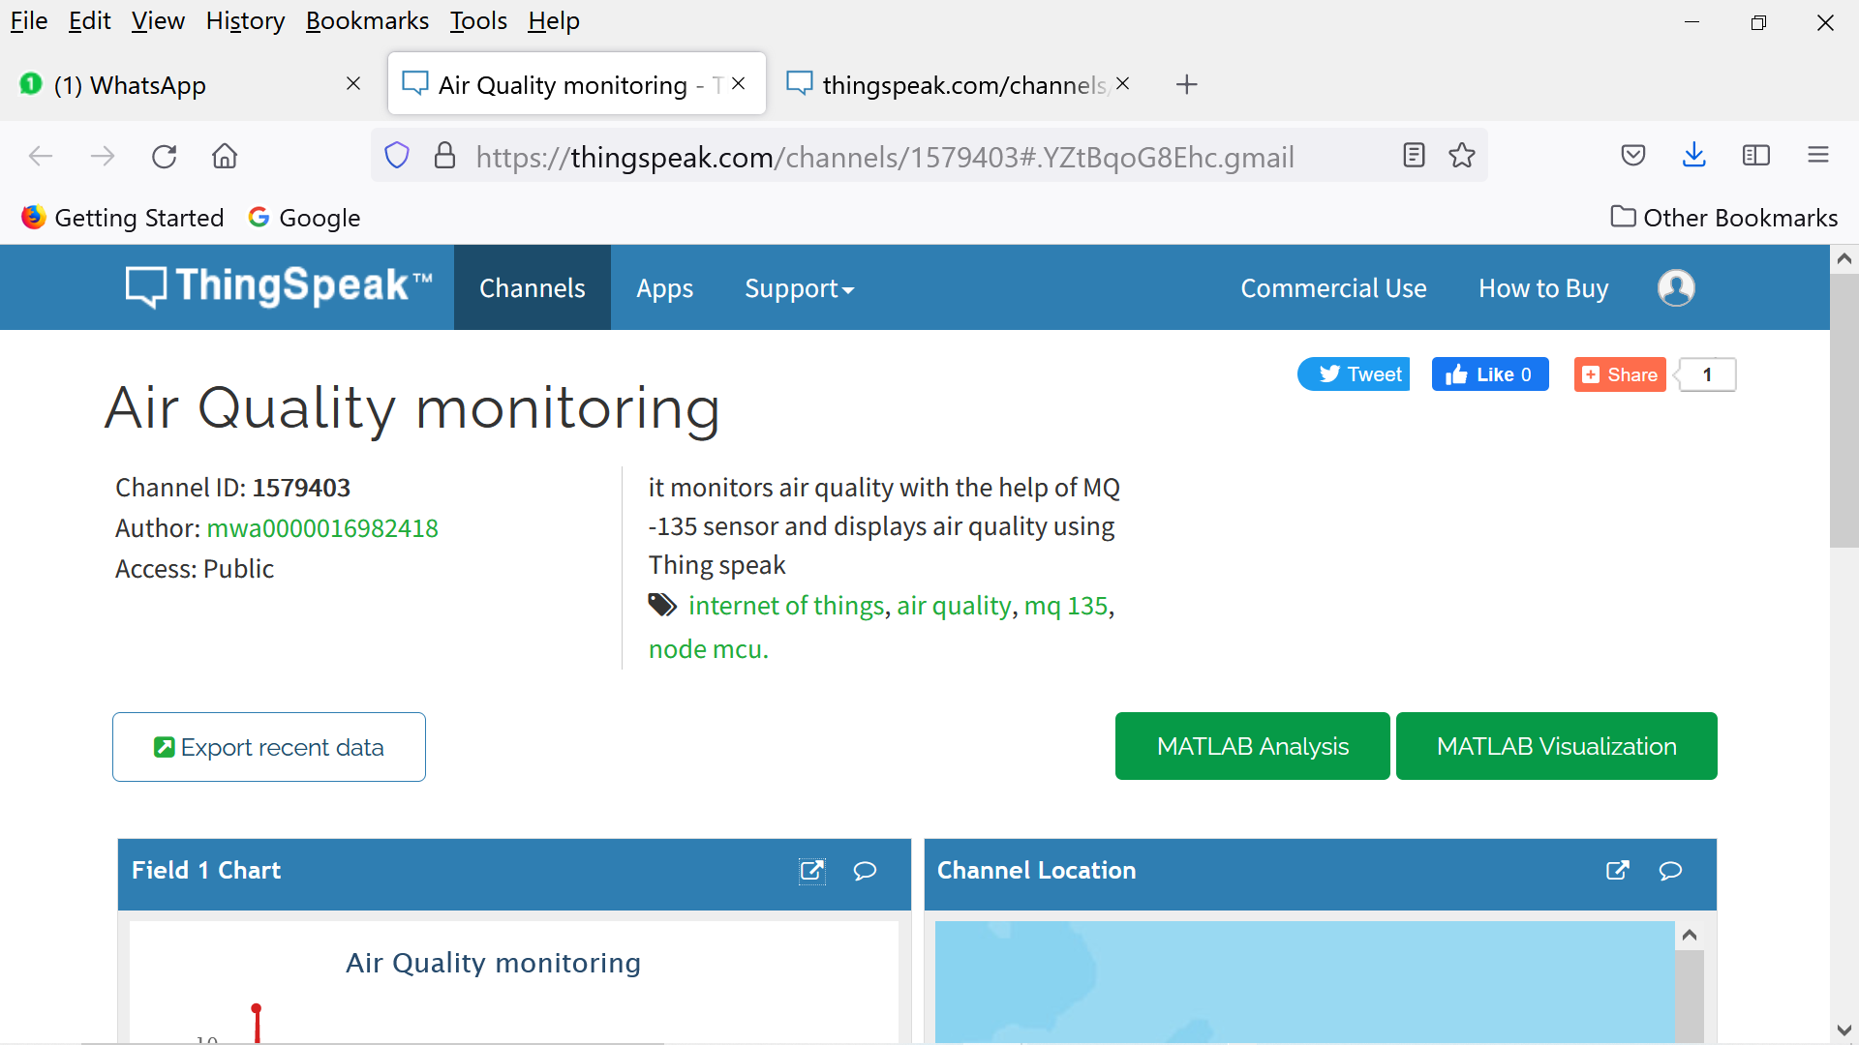
Our thing speak channel for air quality monitoring
2021

Slide 17
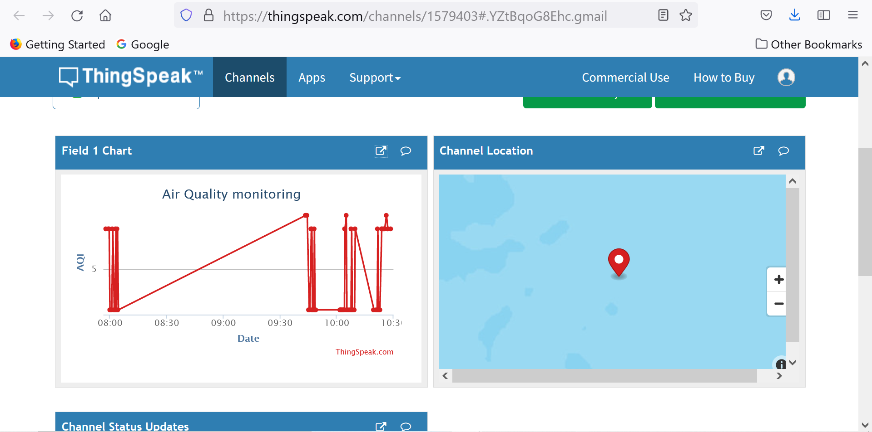
Graph from thing speak

Slide 18
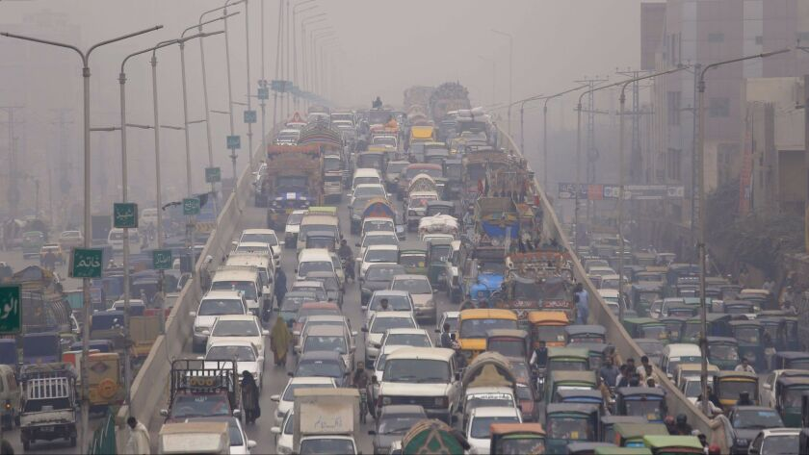
Applications
2021
Air quality monitoring system near traffic signals
Helps to control traffic accordingly
Gives information about air quality of surrounding routes
Warns traffic police about the pollution level so that they can take care of their health
Diverting some routes to reduce the concentration of pollution at one area

Slide 19
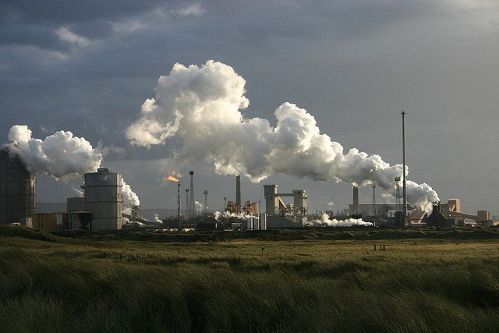
Air quality monitoring in industries
Applications
2021
Industrial pollution is a major source of air pollution
The governments across the globe have enacted strict laws to control the pollution from industries.
The pollution can be measured in real-time for law enforcement and in the implementation of the clean manufacturing practices.

Slide 20
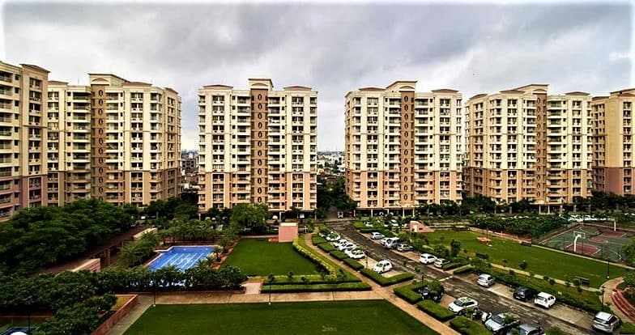
Applications
Air quality monitoring in societies and colonies
2021
Conducting tree plantation programs
Car – free days
Odd – even schemes
Creates awareness on pollutants present in air for localities near industries

Slide 21
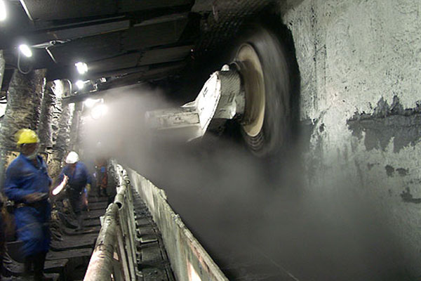
Applications
Air quality monitoring in mines
Detects in case of any gas leak.
Underground air quality can be monitored continuously.
Knowing the concentration of the pollution can help mine operators adopt environmental friendly practices.

Slide 22
References
2021
https://www.aqi.in (Real time AQI)
https://www.airnow.gov/aqi/aqi-basics (for AQI working and basics)
https://iitk.ac.in/new/data/aqi-iitk-web-page.ppt (presentation by IIT Kanpur )
https://ieeexplore.ieee.org/document/8980024
(IEEE paper on measurement of AQI using IOT)

Slide 23
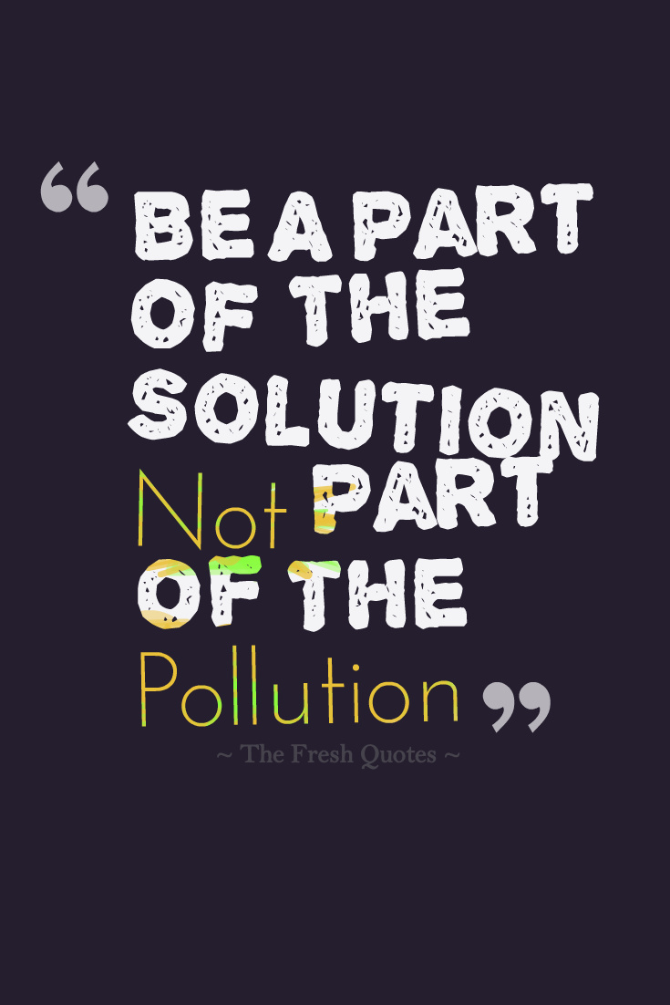
THANK YOU!
2021
TEAM : 19WH1A0227 – BH. SAI SRUTHI – III EEE
19WH1A0229 – P.SNEHA - III EEE
19WH1A0240 –K.GAYATHRI- III EEE
19WH1A0243 –CH.LIKHITHA- III EEE
23

